Slide 1
ShareEats: A Leftover Food Donation Platform
Rejitha K P
S3 MCA
Roll No: 22
Guide:- Sruthy K Joseph
Assistant Professor
CSE

Slide 2
INTRODUCTION
"ShareEats: A Leftover Food Donation platform" Project is a web-based technology that manages foods.
This website provides the interface between food donors and those who requires the food.
In this website, food donor enters their food quantity details and addresses and then the admin maintain the details of food donor.

Slide 3
INTRODUCTION
The donor can create the account and whenever they are having leftover food they can login and give request to the admin. And the admin also maintain the buyer (orphanage, poor people,..) details too.
After the admin view the donor request and give the alert message like time to come and collect the food.

Slide 4
EXISTING SYSTEM
In the existing system if anyone has extra food because of any function or in their home it will be waste because instantly there is no way to share with anyone..
Even if they want to give that extra food to any orphanage or poor people they don’t have time or don’t have an idea about that.

Slide 5
PROPOSED SYSTEM
The proposed system reduces the food wastage with the help of web technology.
This project is redistribution of food and enormously successful social innovation that tackles food waste and food poverty.
The admin collect food details from the donor and send the donor details to nearby agent and the agent delivers the food to the nearest orphanages or poor people.
After receiving the food from the agent by admin and give alert message to that donor.
Through this way we can reduce food wastage problem.

Slide 6
LITERATURE SURVEY
In almost the last decade, food waste and food losses have become interesting topics among researchers.
This review of literacy is carried out in order to determine the extent to which research on food loss and food waste is carried out and the use of what methods are most often used.
In this study the main sources of research data are sixty scientific articles over the last few years starting from 2009 to 2018 relating to food waste and waste.
Search for scientific articles is done by using online search via (via ProQuest, Elsevier and Google Scholar) and using the keywords ‘Food loss and food waste’.

Slide 7
LITERATURE SURVEY
The results of the review found that research on food loss and food waste experienced an upward trend from 2011 to 2014.
The comparison of the highest number of articles discussing food loss and food waste was in 2014 with seventeen scientific articles and in 2011 was the year which had the fewest articles,namely only one article.
The results of the review also show that the most frequently used method is quantitative methods. There are thirty-four articles using quantitative methods and twenty-six articles using qualitative methods.
It is strongly recommended further research to use qualitative methods regarding food loss and food waste.

Slide 8
MODULES
This project consist of the different types of modules.
The modules are:
1.Donor Module
2.Agent Module
3.Admin Module

Slide 9
ADMIN MODULE
The administrator maintain the agent details as well as the donor details.
Whenever the donor post the availability of food the admin will notify the nearby agent immediately.
The administrator give the orphanage details directly to the donor.

Slide 10
ADMIN MODULE
User Management: Allows the admin to create,edit and manage user accounts,including donors and agents.
Food Donation Management: Enables the admin to oversee the entire donation process,including accepting or rejecting donations,assigning agents and monitoring food inventory.
Dashboard: Admin can view ongoing activities such as pending pickups, recent donations and system alerts.

Slide 11
ADMIN MODULE
Donor Management: Admin has the ability to approve or reject donor registrations and have access to donor profiles and donation history.
Agent Management: Admin can approve or reject agent registrations and can access to agent profiles and pickup history.
Communication: Admin can communicate with donors and agents and provide automated notifications for important updates.

Slide 12
DONOR MODULE
The donor give the leftover food to the orphanage.
Donor give the request to the admin for the purpose of collecting the food through agent.
The donator view the orphanage details and agent details.

Slide 13
DONOR MODULE
Registration and Profile Management: Allows donors to create and manage their profiles including contact information and donation preferences.
Food donation: Enables donors to input details of food donations,including type,quantity,expiration date and pickup availability.
Donation Tracking: Can View the status of submitted donations and receives notifications on donation acceptance and pickup schedules.
History and Feedback: Displays history of previous donations made by the donor and provides feedback on pickup experiences.

Slide 14
AGENT MODULE
The agent maintain the orphanage details.
Agent can also maintain the donor details.
When admin notify the availability of food to the agent,the agent will collect the food from the donor and deliver to needy people.

Slide 15
AGENT MODULE
Registration and Profile Management: Allows agents to create and manage their profiles including contact information and availability.
Pickup Scheduling: Allows agents to schedule and manage the pickup and delivery of donated food.

Slide 16
AGENT MODULE
Confirmation and Feedback: Confirms successful
pickups and provide feedback on the donation pickup process.
Communication: Communicate with donors and admin regarding pickup details.

Slide 17
SOFTWARE REQUIREMENTS
Operating System : Windows
Front End : HTML,CSS, JavaScript Back End : PHP
Webserver : Xampp Server
Database : MySQL
IDE : VS Code

Slide 18
DATA FLOW DIAGRAMS

Slide 19
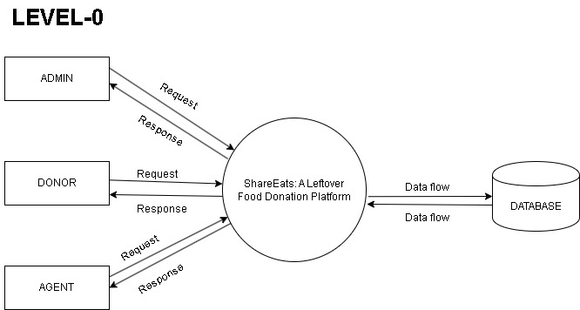
DATA FLOW DIAGRAM

Slide 20
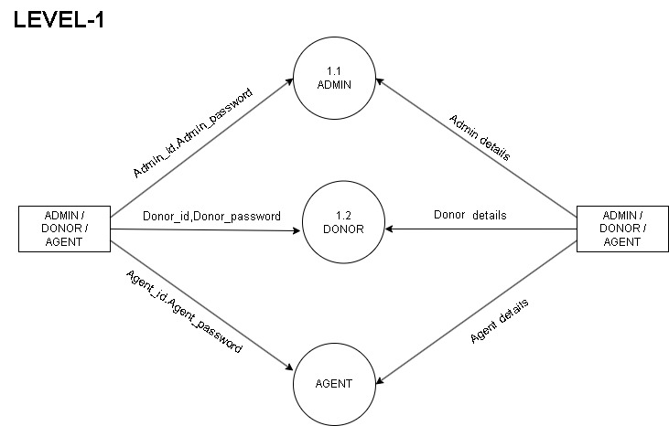
DATA FLOW DIAGRAM

Slide 21
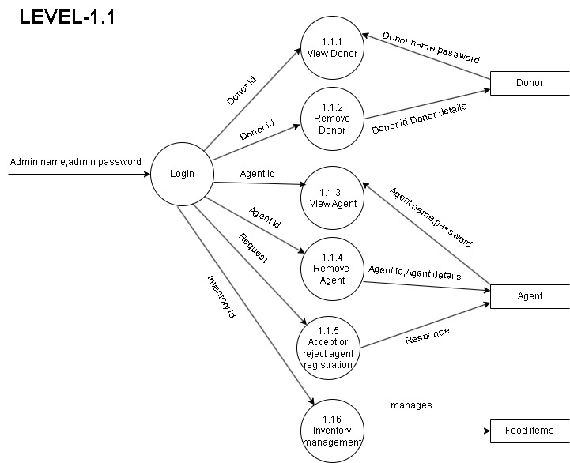
DATA FLOW DIAGRAM (ADMIN)

Slide 22
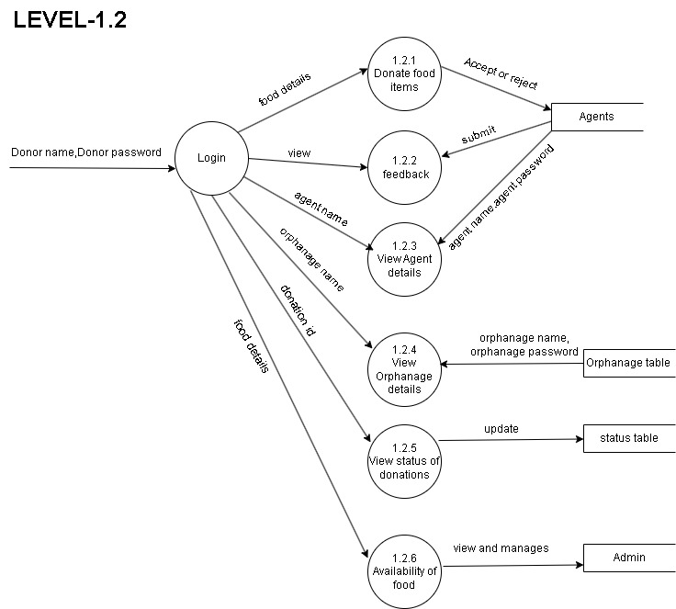
DATA FLOW DIAGRAM (DONOR)

Slide 23
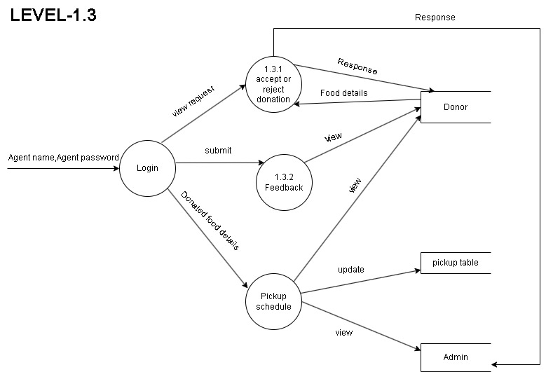
DATA FLOW DIAGRAM (AGENT)

Slide 24
TABLES

Slide 25
TABLE NAME: DONOR REGISTRATION
FIELD NAME | DATA TYPE | CONSTRAINTS
Donor_id | INT | Primary Key
Name | VARCHAR | Not Null
Email | VARCHAR | Not Null
Password | VARCHAR | Not Null
Gender | VARCHAR | Not Null

Slide 26
FIELD NAME | DATA TYPE | CONSTRAINTS
Admin_id | INT | Primary key
Name | VARCHAR | Not Null
Email | VARCHAR | Not Null
Password | VARCHAR | Not Null
Location | VARCHAR | Not Null
Address | VARCHAR | Not Null

Slide 27
TABLE NAME: AGENT REGISTRATION
FIELD NAME | DATA TYPE | CONSTRAINTS
Agent_id | INT | Primary Key
Name | VARCHAR | Not Null
Email | VARCHAR | Not Null
Password | VARCHAR | Not Null
City | VARCHAR | Not Null

Slide 28
TABLE NAME: LOGIN
FIELD NAME | DATA TYPE | CONSTRAINTS
Id | INT | Primary Key
Username | VARCHAR | Not Null
Email | VARCHAR | Not Null
Password | VARCHAR | Not Null

Slide 29
TABLE NAME: DONATION
FIELD NAME | DATA TYPE | CONSTRAINTS
D_id | INT | Primary Key
Name | VARCHAR | Not Null
Email | VARCHAR | Not Null
Food | VARCHAR | Not Null
type | VARCHAR | Not Null
Quantity | VARCHAR | Not Null
Date | DATE | Not Null
Phone No | INT | Not Null
Address | VARCHAR | Not Null
Location | VARCHAR | Not Null
Delivery_by | VARCHAR | Not Null
Deliver_to | VARCHAR | Not Null

Slide 30
TABLE NAME: FEEDBACK
FIELD NAME | DATA TYPE | CONSTRAINTS
F_id | INT | Primary Key
Email | VARCHAR | Not Null
Feedback | VARCHAR | Not Null
date | DATE | Not Null

Slide 31
TABLE NAME: STATUS
FIELD NAME | DATA TYPE | CONSTRAINTS
Status_id | INT | Primary Key
Status_name | VARCHAR | Not Null
Description | VARCHAR | Not Null

Slide 32
TABLE NAME: ORPHANAGE DETAILS
FIELD NAME | DATA TYPE | CONSTRAINTS
Orphanage_id | INT | Primary Key
Name | VARCHAR | Not Null
address | VARCHAR | Not Null
Contact_info | VARCHAR | Not Null
Capacity | INT | Not Null

Slide 33
SCREENSHORTS

Slide 34
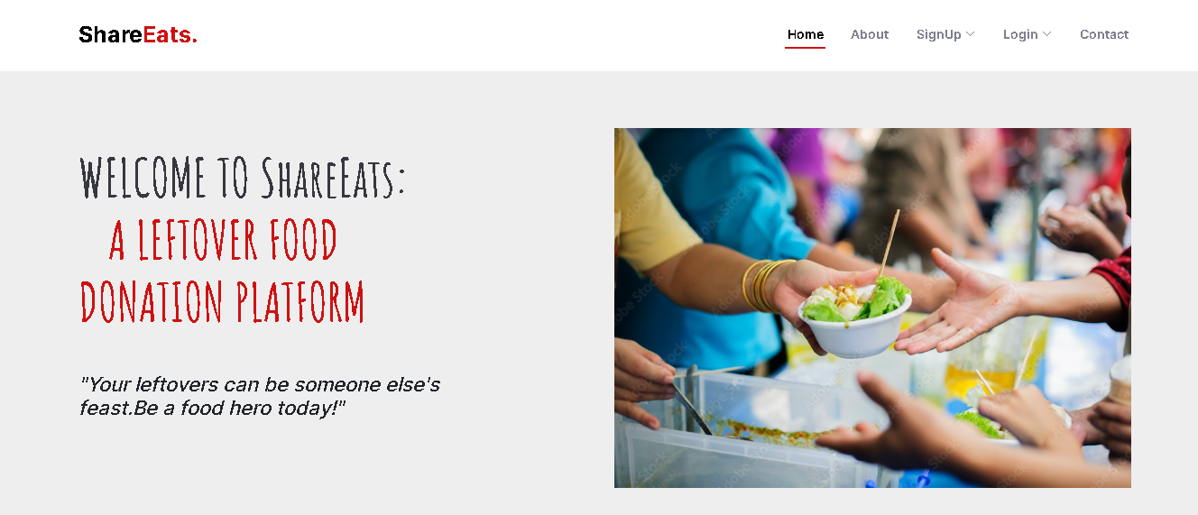
HOME PAGE

Slide 35
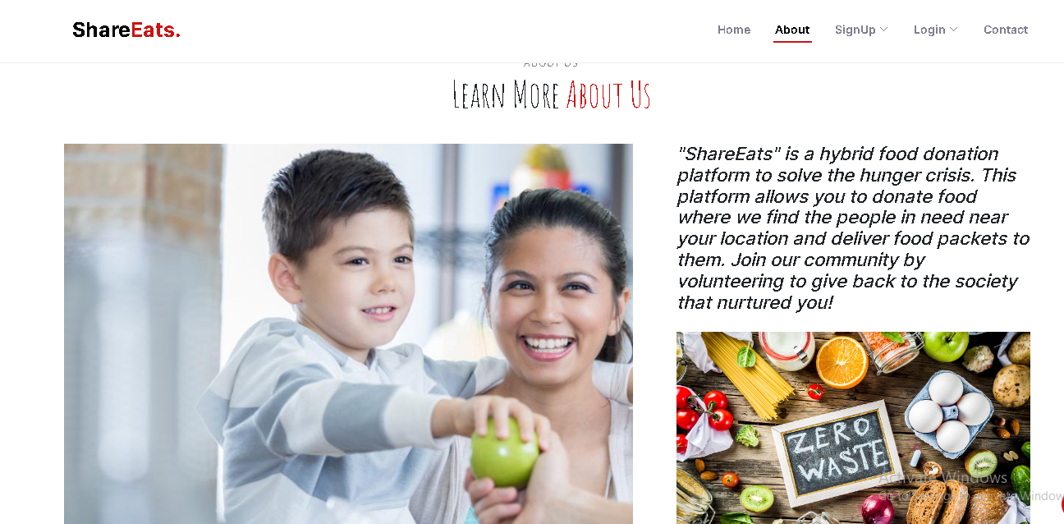
ABOUT

Slide 36
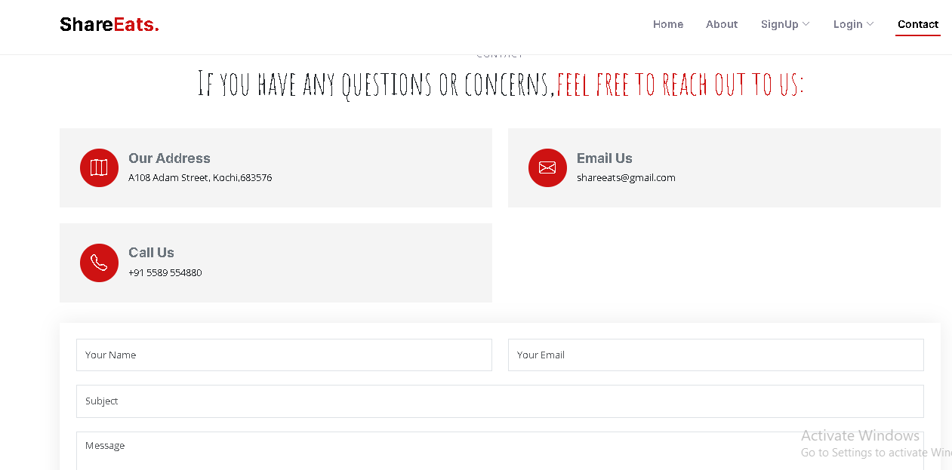
CONTACT

Slide 37
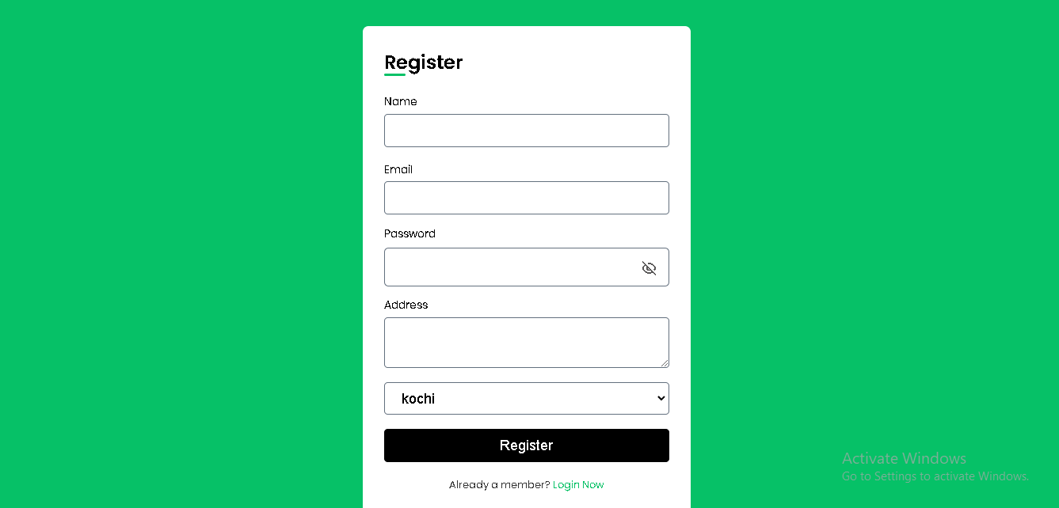
ADMIN REGISTRATION

Slide 38
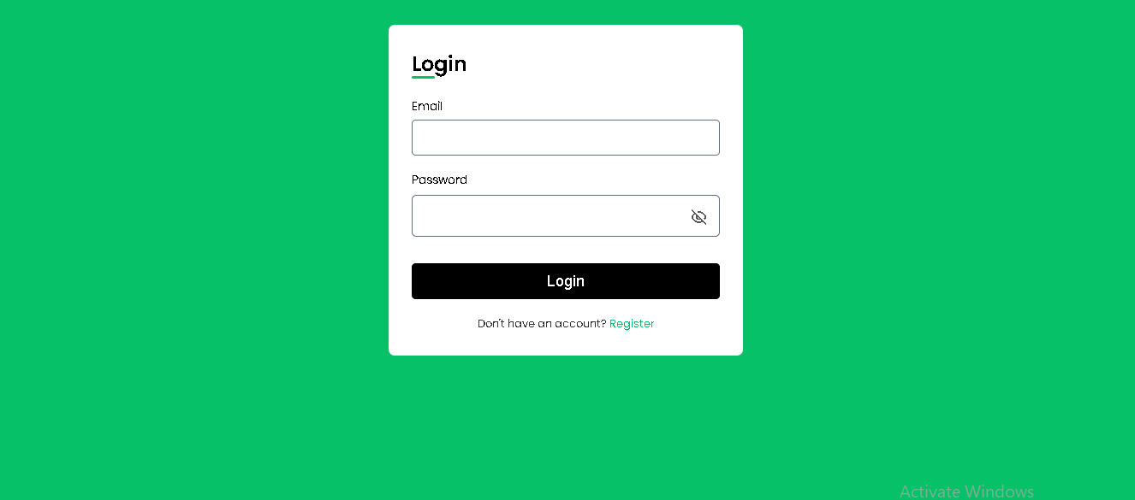
ADMIN LOGIN

Slide 39
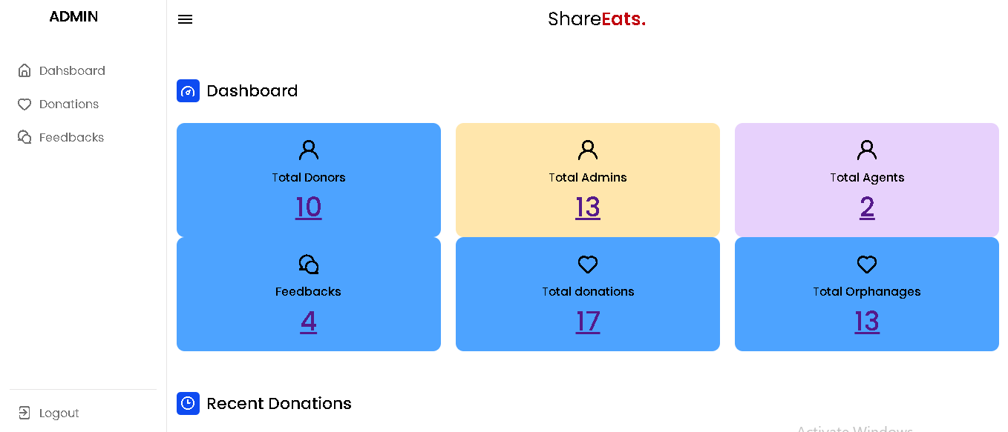
ADMIN DASHBOARD

Slide 40
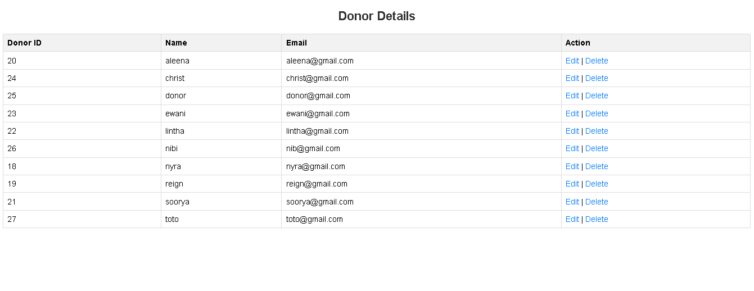
TOTAL DONORS

Slide 41
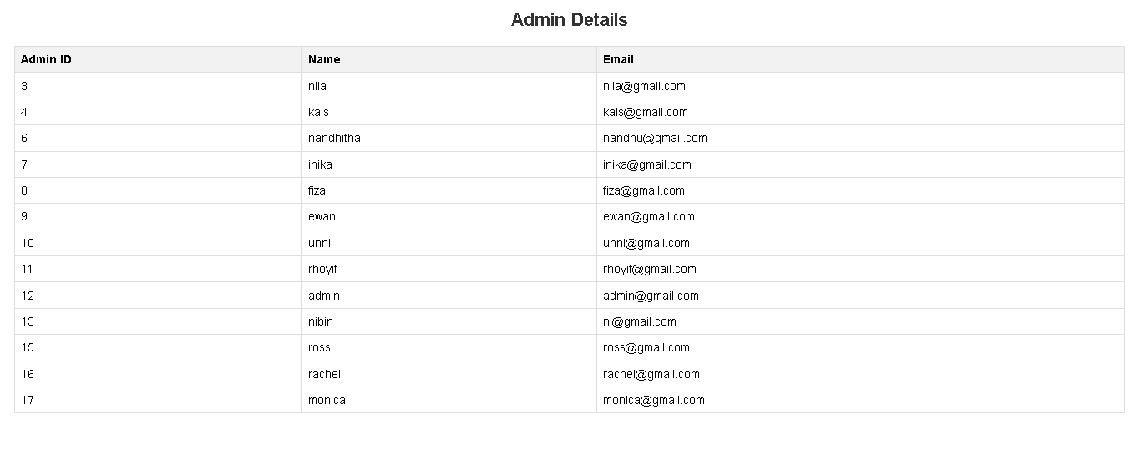
TOTAL ADMINS

Slide 42
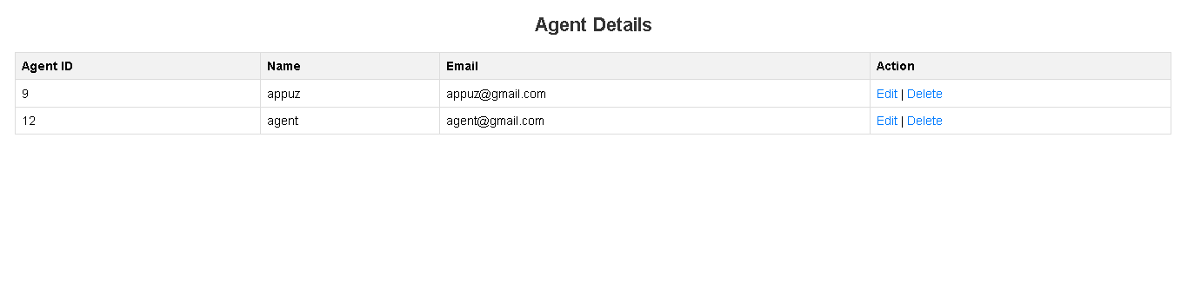
TOTAL AGENTS

Slide 43
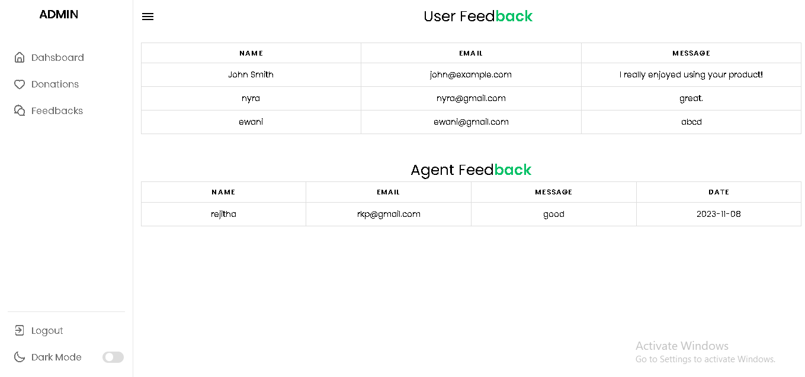
FEEDBACKS

Slide 44
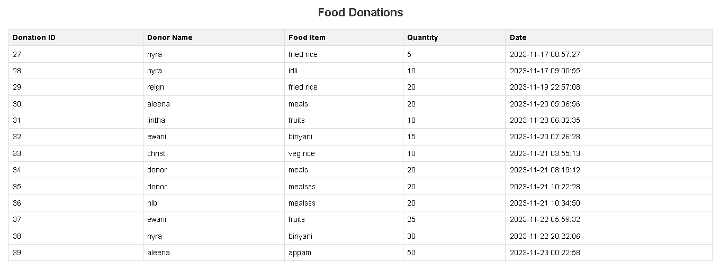
TOTAL DONATIONS

Slide 45
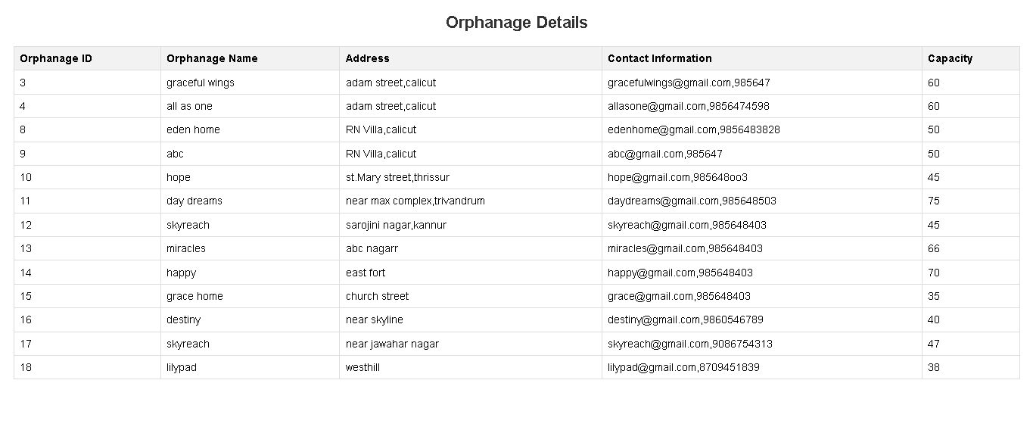
TOTAL ORPHANAGES

Slide 46
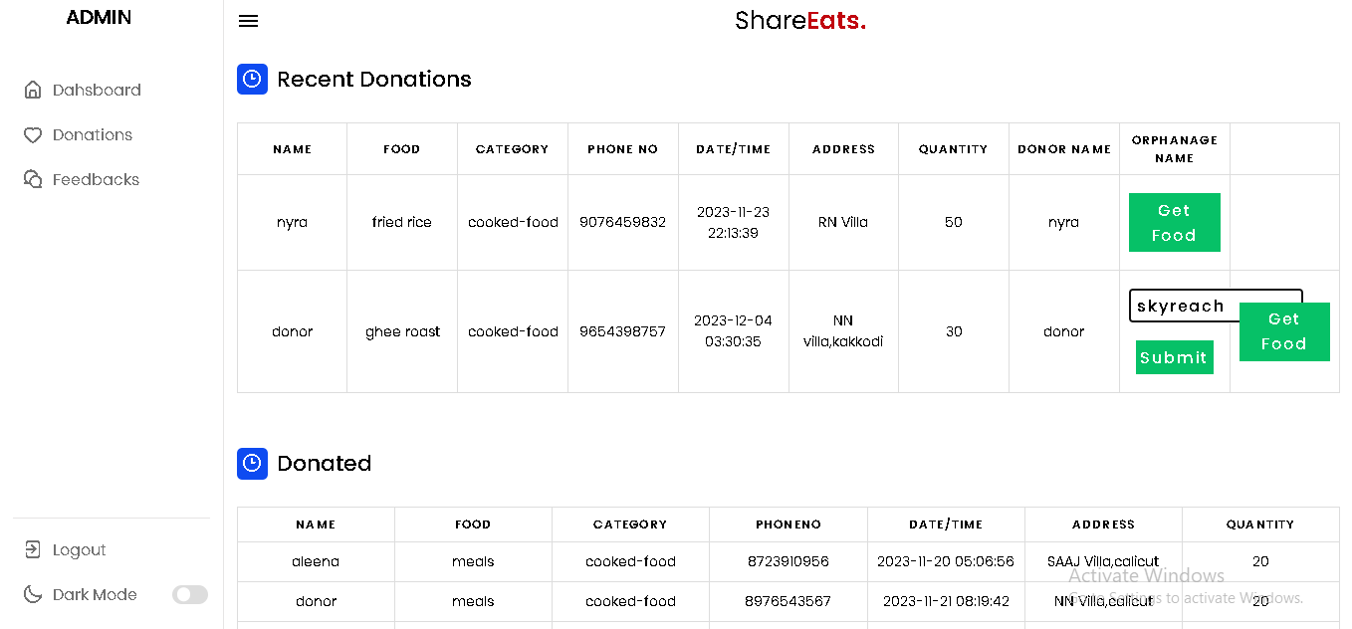
RECENT DONATIONS& DONATED

Slide 47
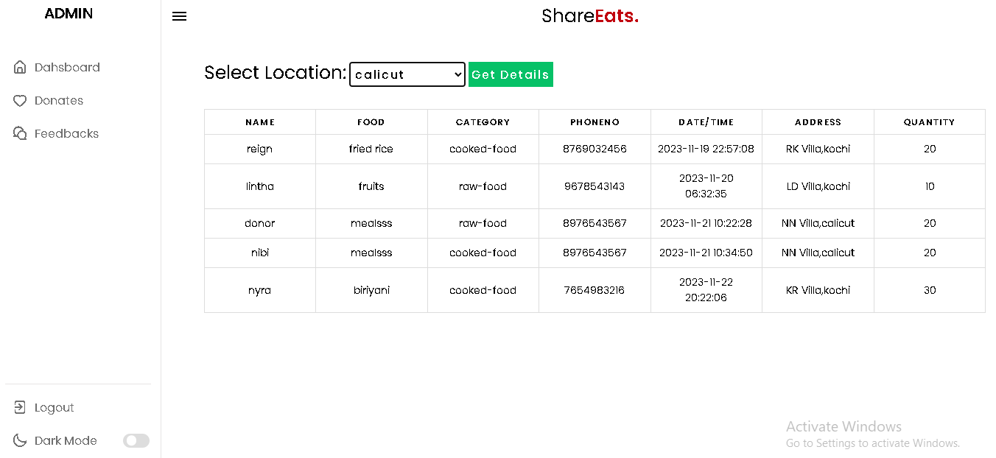
DONATION DETAILS (CITY WISE)

Slide 48
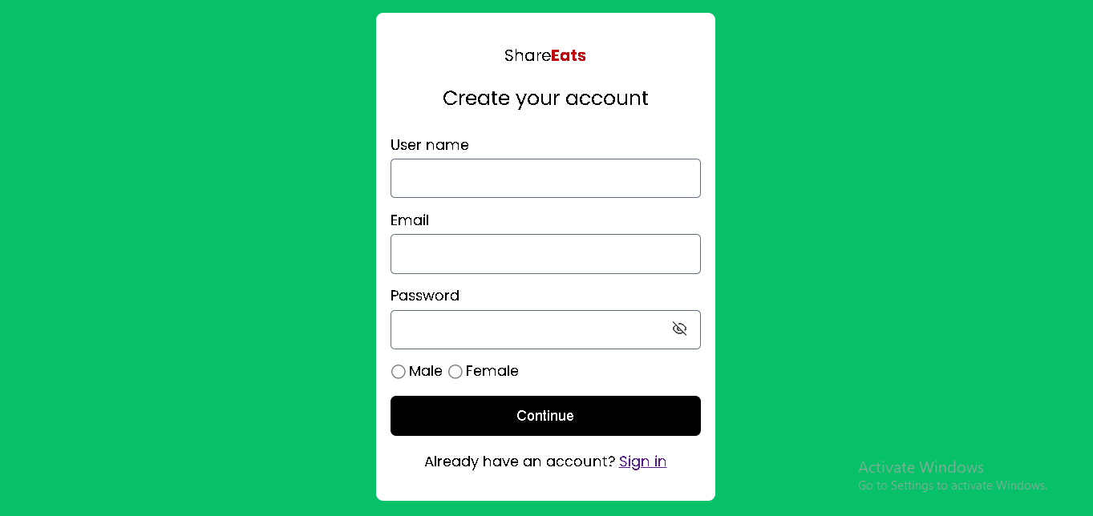
DONOR REGISTRATION

Slide 49
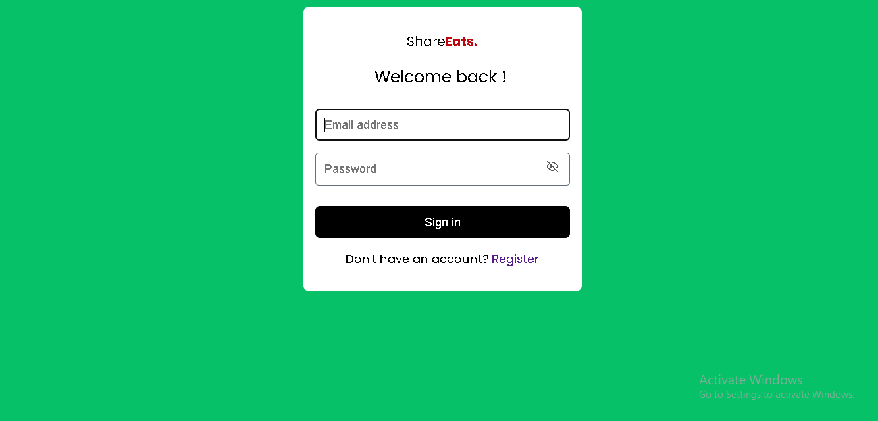
DONOR LOGIN

Slide 50

DONOR HOME PAGE

Slide 51
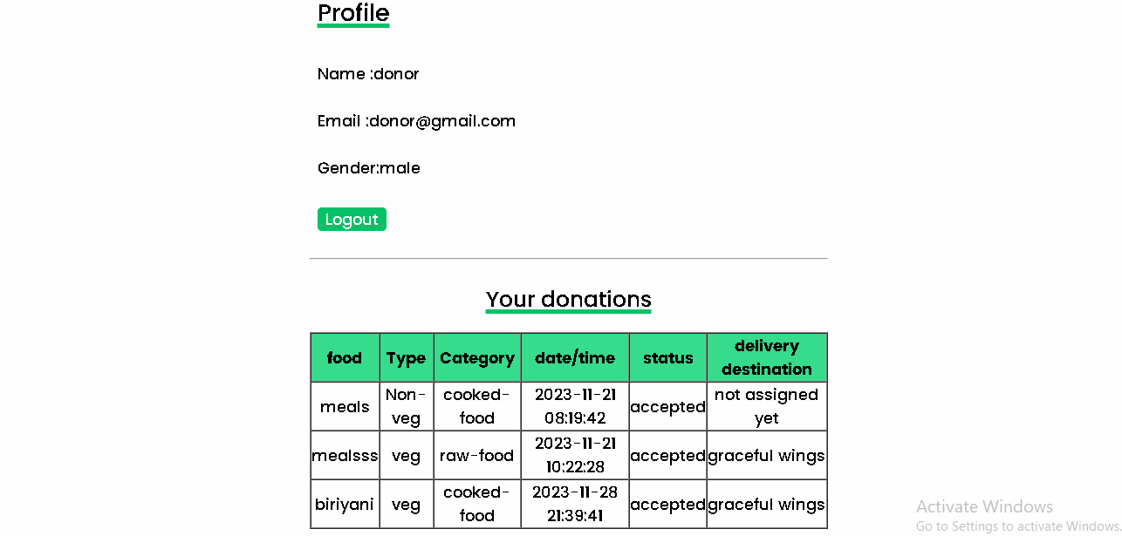
DONOR PROFILE

Slide 52
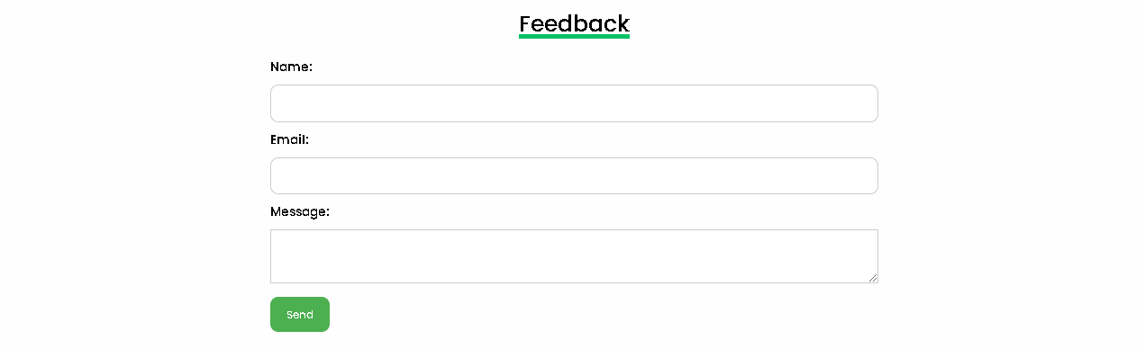
DONOR FEEDBACK

Slide 53
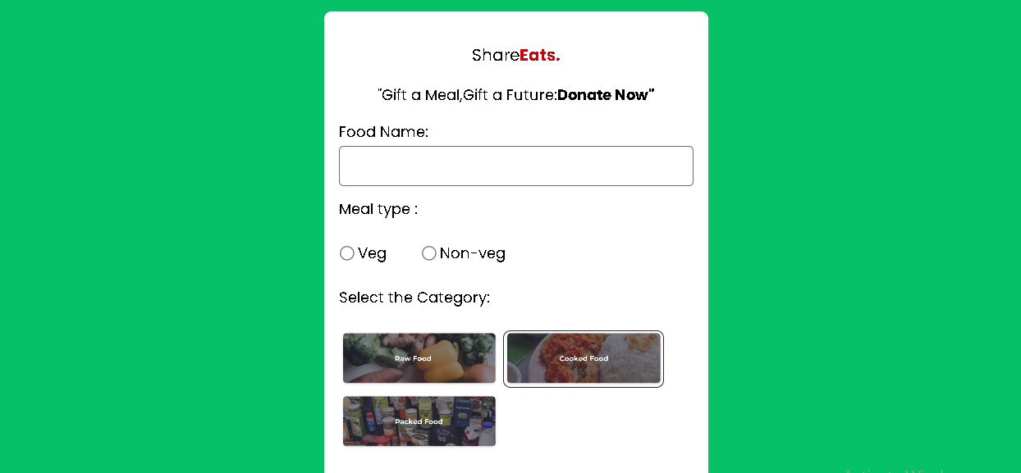
FOOD DONATION

Slide 54
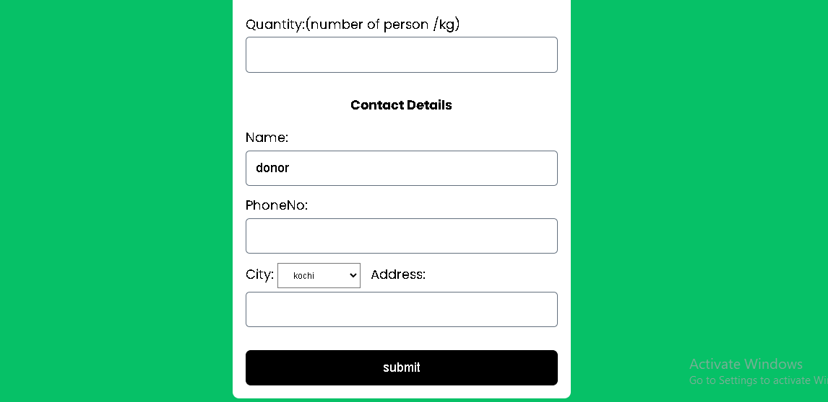
FOOD DONATION

Slide 55
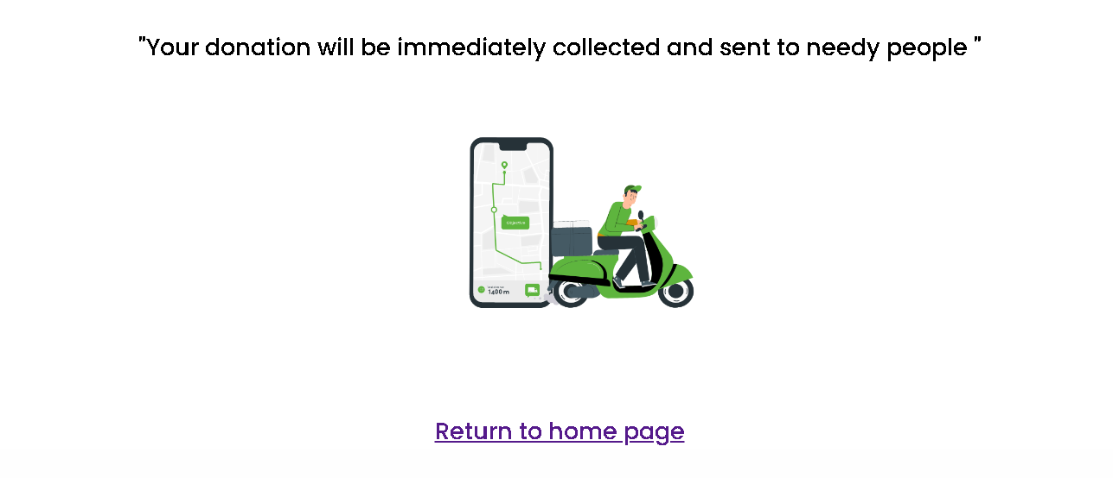

Slide 56
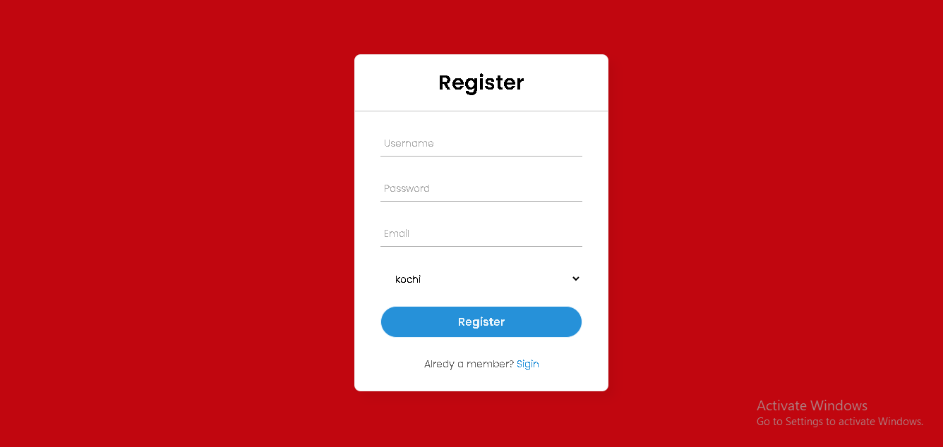
AGENT REGISTRATION

Slide 57
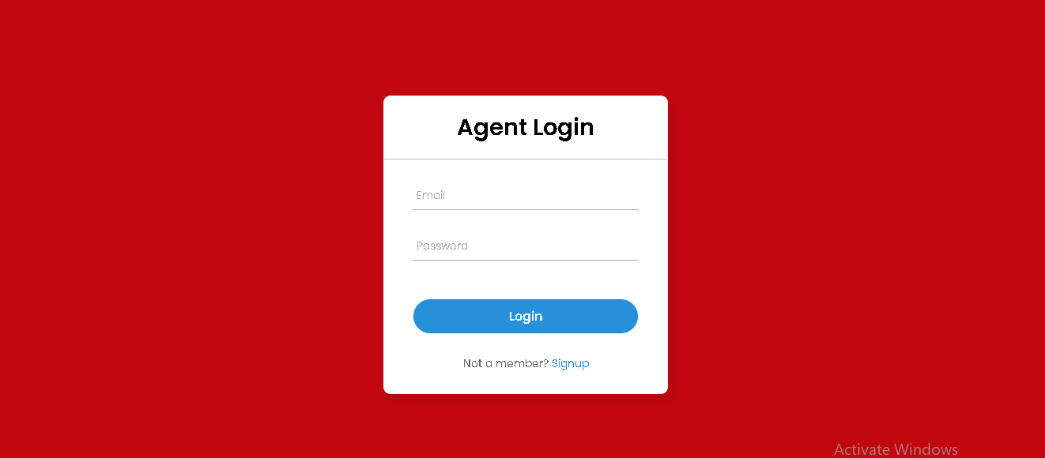
AGENT LOGIN

Slide 58
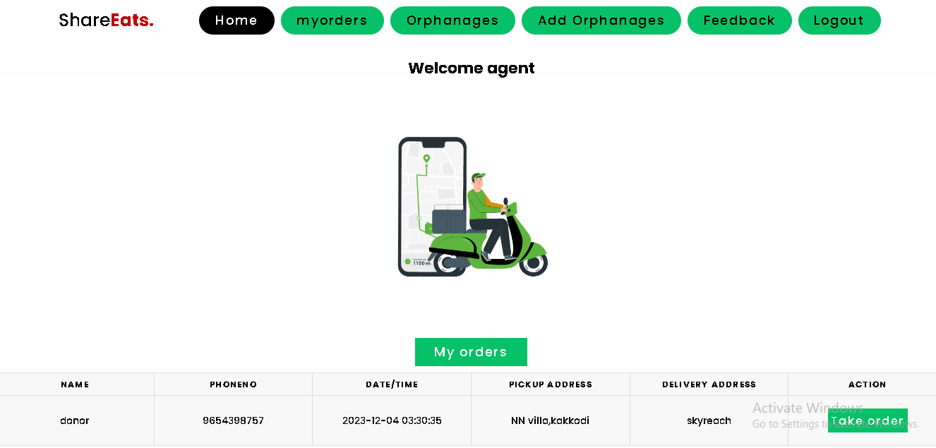
AGENT HOME PAGE

Slide 59
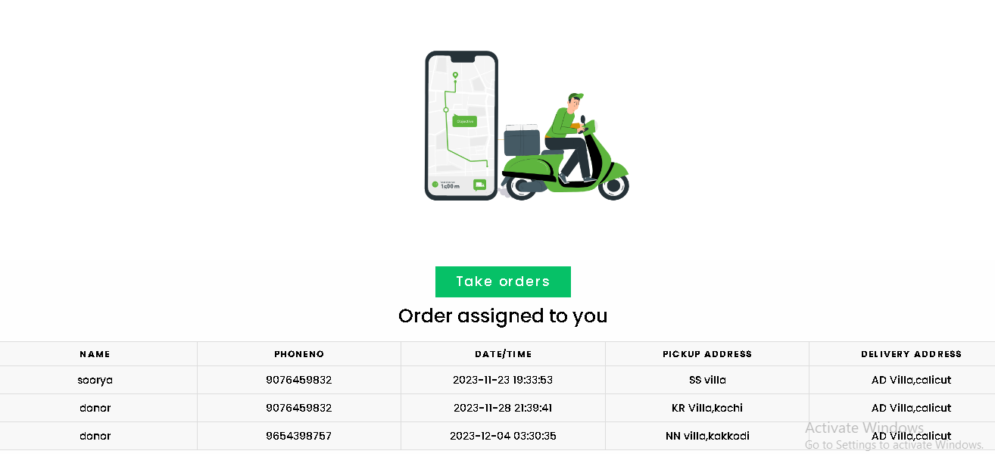
ORDERS

Slide 60
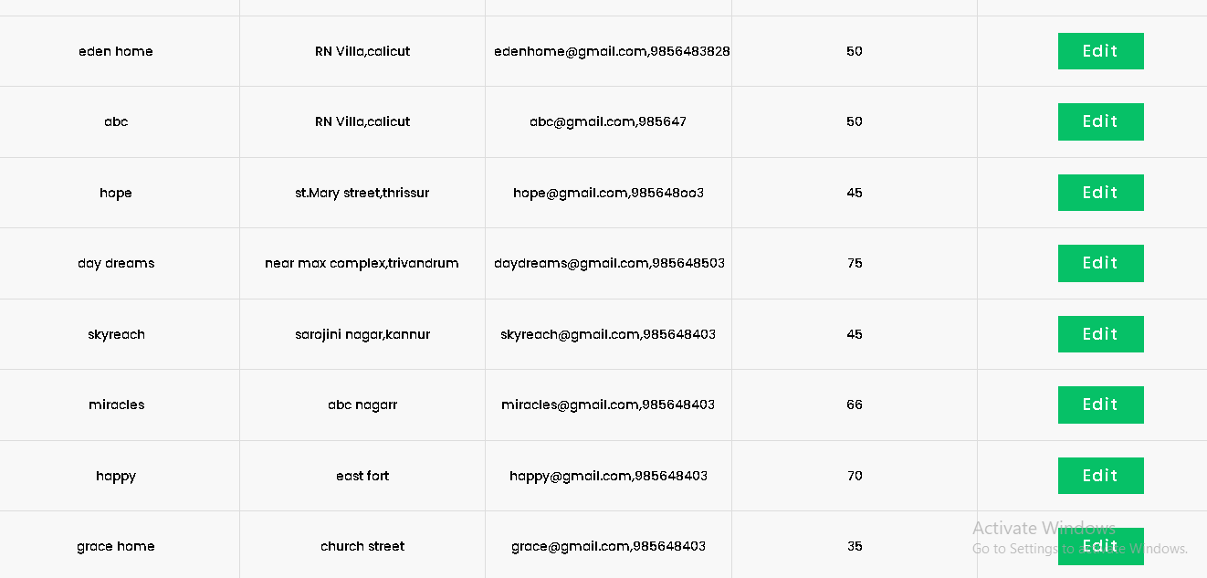
ORPHANAGES

Slide 61
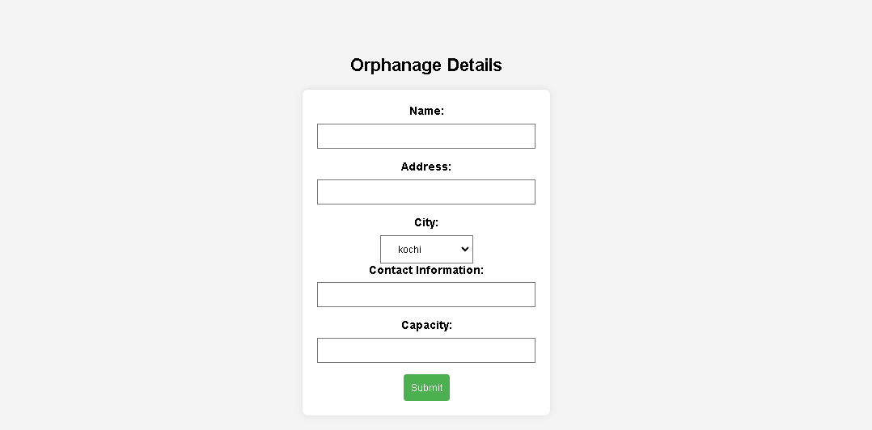
ADD ORPHANAGES

Slide 62
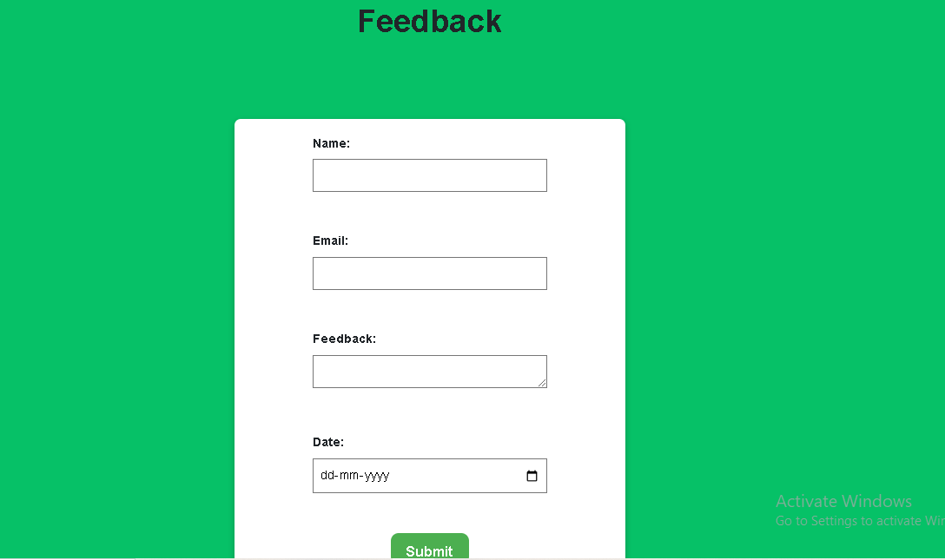
FEEDBACK

Slide 63
THANK YOU

